Slide 1
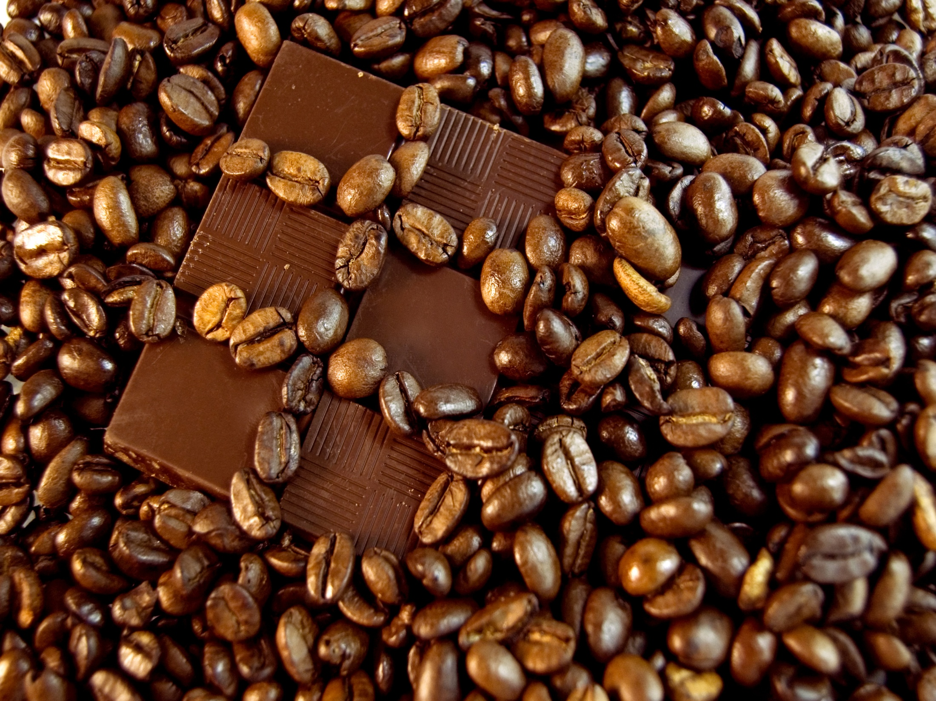


FAIR TRADE CAMPUS WEEK
September 23-27

Slide 2
Monday (Drink Fair)
Fairtrade hot chocolate, coffee, and tea giveaway
8:30-2:00 in front of the ARC grocery store
Tuesday (Eat Fair)
Fairtrade bake sale and Camino snack bar sale
11:00-4:00 in front of the ARC grocery store
Wednesday (Play Fair)
Soccer ball shooting game; contest to win Fairtrade gift pack
11:30-4:30 in front of Douglas Library
Fairtrade themed Member Learning! (bring bowl and spoon)
Thursday (Speak Fair)
Coffeehouse at CoGro
6:30-10:00
Friday (Buy Fair)
Booth with information about Fairtrade certified products and where you can buy them in Kingston
11:30-6 in front of the ARC grocery store

